Slide 1
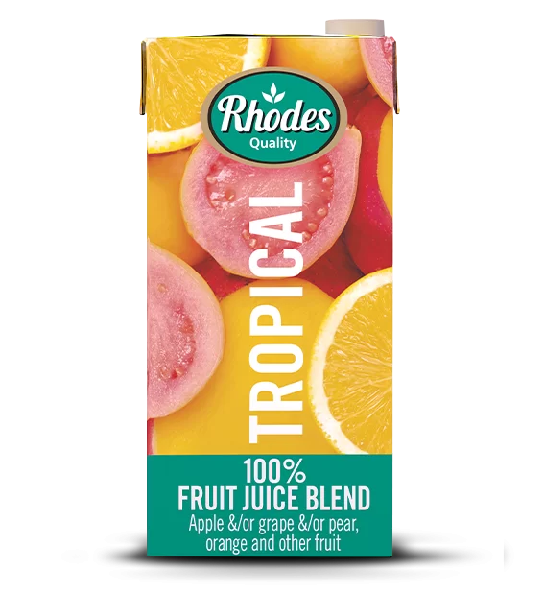
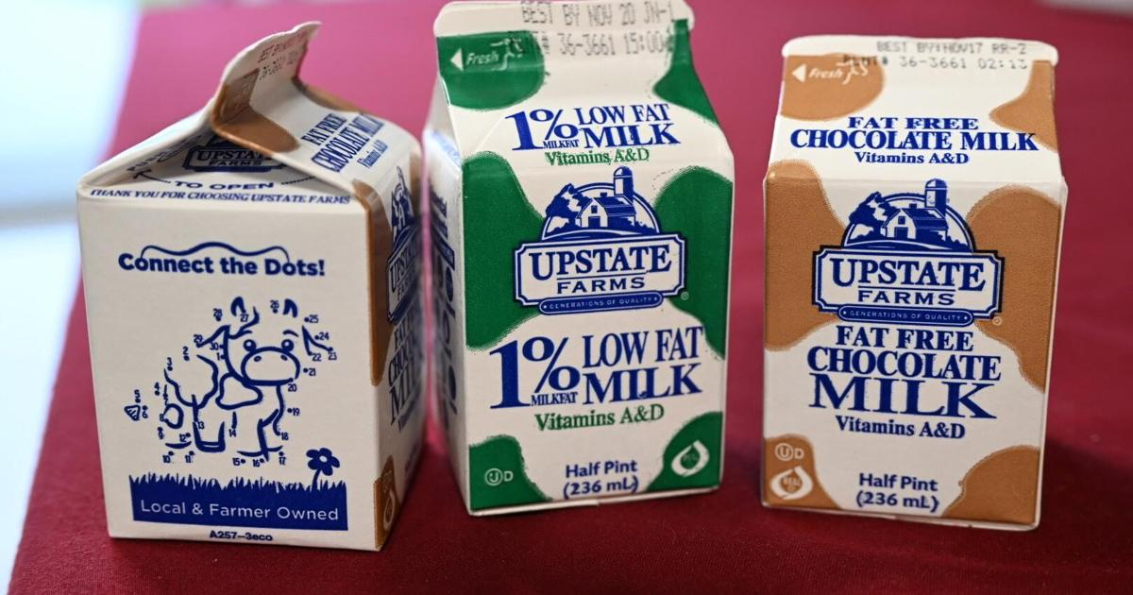
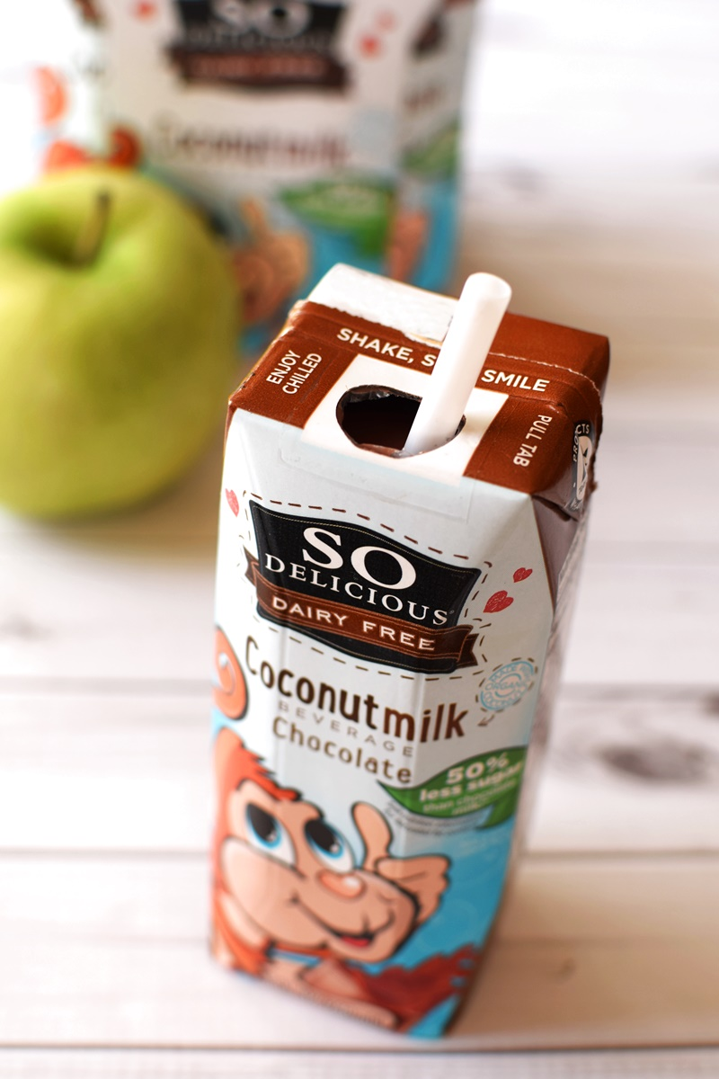
What’s your favorite drink at school?
How often do you buy drinks at school?
How much do you think you spend on drinks in one school week?

Slide 2
What do you notice?
Items |  | Quantity |  | Price (USD) | Amount
Account Deposit |  | 1 |  | ($30.00) | ($30.00)
Chocolate Milk 09/10/2024 |  | 1 |  | $0.70 | $0.70
Chocolate Milk 09/15/2024 |  | 1 |  | $0.70 | $0.70
Chocolate Milk 09/17/2024 |  | 1 |  | $0.70 | $0.70
Chocolate Milk 09/22/2024 |  | 1 |  | $0.70 | $0.70
Chocolate Milk 09/26/2024 |  | 1 |  | $0.70 | $0.70
 |  |  | Total: |  | ($26.50)
 |  |  | Amount Due (USD): |  | ($26.50)
What do you think this table is for? Discuss!
Why are some numbers in brackets?

